Slide 1
BIOS247: Experimental evolution and whole genome sequencing: From flies to yeast
July 29, 2024
Notes:
Experimental evolution is a powerful way to probe the genetic basis of rapid adaptation. However, finding and implementing a computational pipeline for processing and analyzing sequencing data can be difficult for newcomers.
In this course, we will explore the key concepts of these high-powered experiments, and then together, we will analyze real experimental evolution data generated from our studies of yeast and fruit flies.
As the course starts, I would like to provide some background on experimental evolution, how I used experimental evolution in my research, and will go through types of analyses and corresponding teaching modules next week

Slide 2
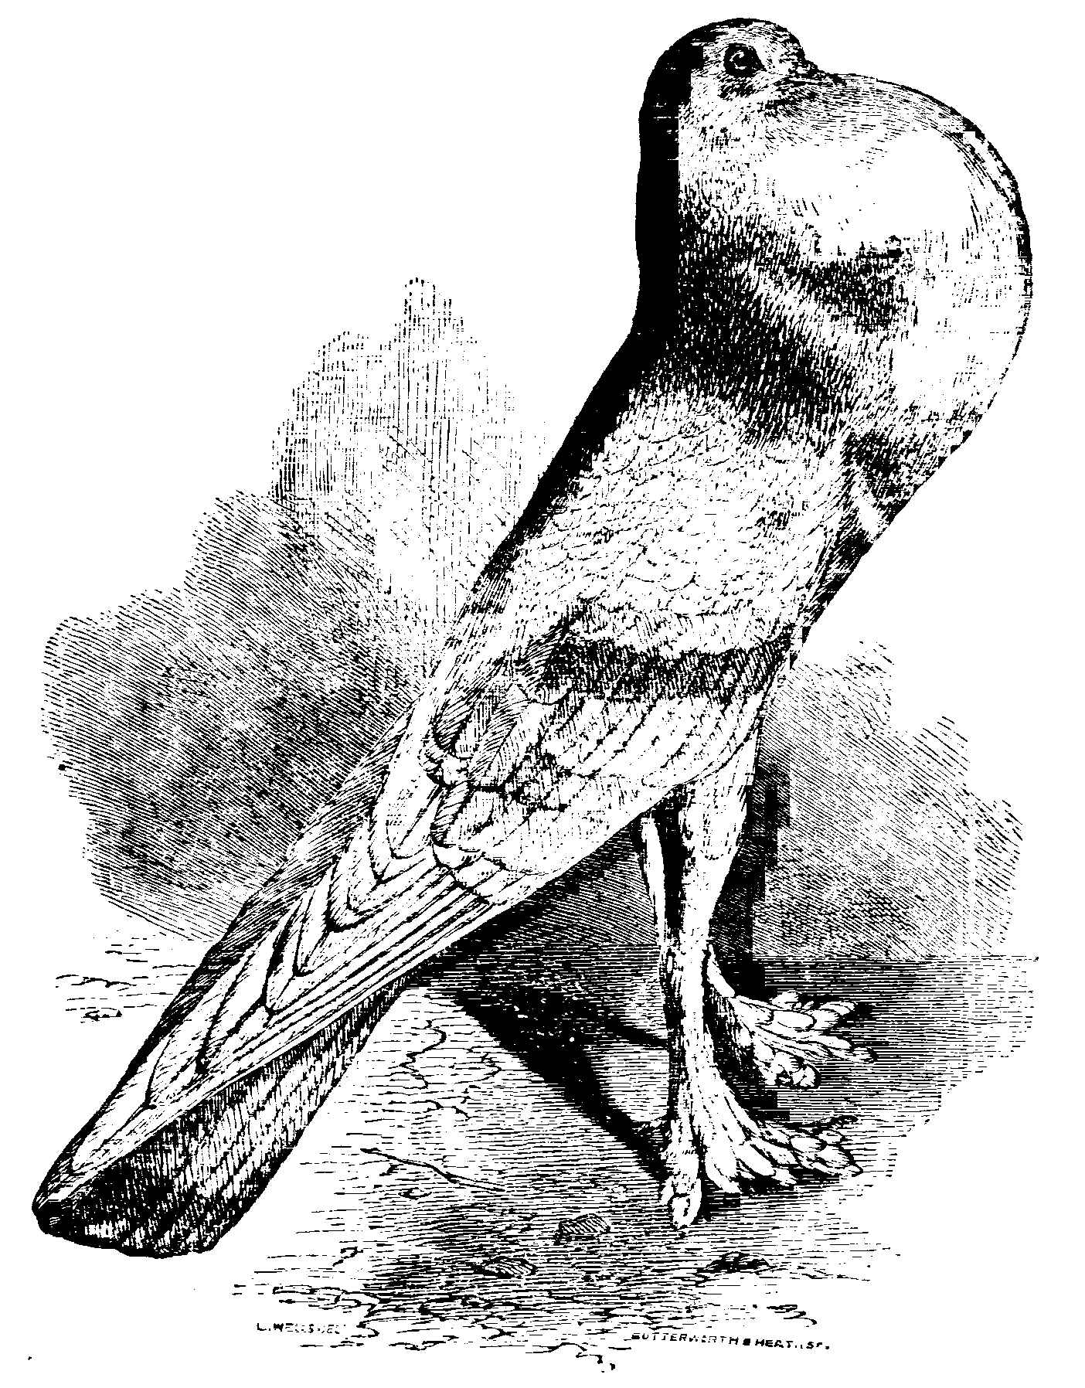
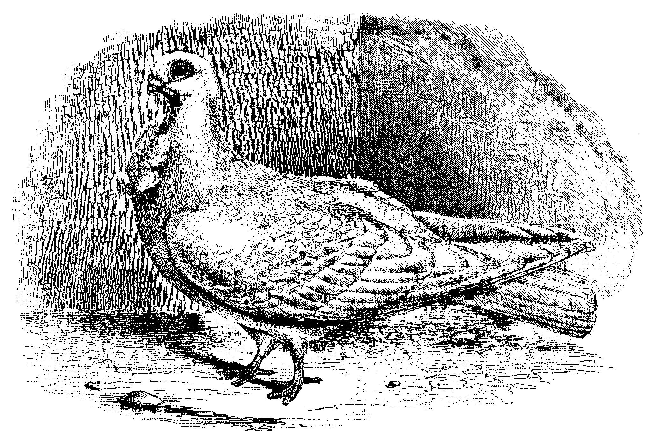
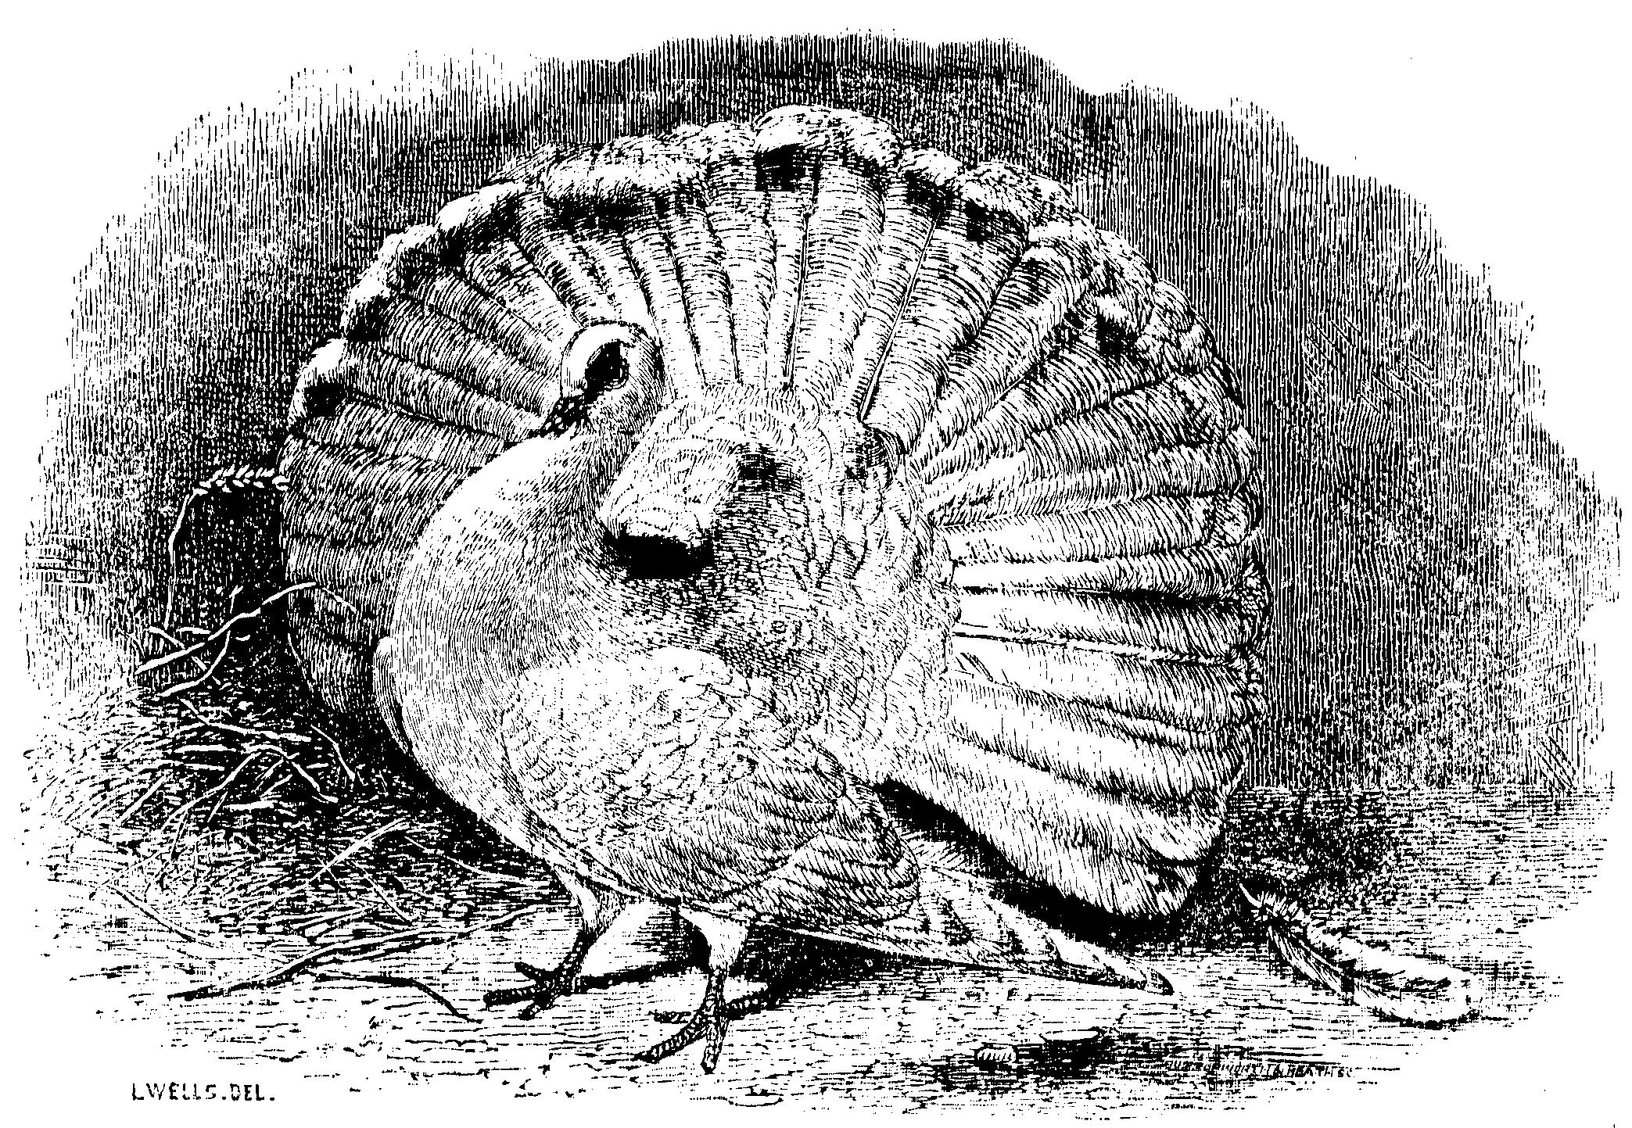
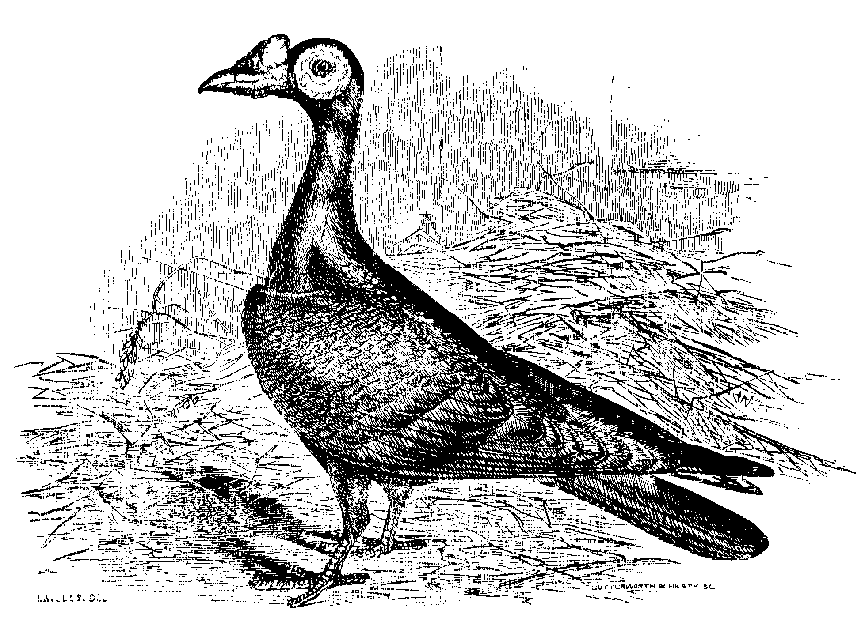
Domestication: Oldest experimental evolution in human history
Charles Darwin on Domestic Pigeons (1868)
“I have been led to study domestic pigeons with particular care, because the evidence that all the domestic races have descended from one known source is far clearer than with any other anciently domesticated animal.”
— The Variation of Animals and Plants Under Domestication
Notes:
Unintended Experiments: Unwittingly, humans have conducted evolution experiments by domesticating plants and animals, impacting species far beyond their natural evolution.
Selective Breeding: This practice has produced varieties that are significantly different from their wild-type ancestors, such as the diverse cabbage varieties, maize, and the numerous dog breeds.
Historical Recognition: Charles Darwin recognized the transformative power of human breeding to create dramatic variations within a single species. Darwin was an avid breeder of fancy pigeons. He used fancy pigeon breeding to exemplify his theory of artificial selection (breeds of fancy pigeons)
Richard Bailey
https://caterpickles.com/2018/11/21/why-was-darwin-so-obsessed-with-pigeons/
Dom117.pnghttps://www.nature.com/articles/nature.2013.12334
https://www.theguardian.com/environment/gallery/2014/jan/31/fancier-pigeons-in-pictures

Slide 3
Experimental evolution: Grow, Select, Repeat
Define initial condition:
Which organism (E.coli, S. cerevisiae, Drosophila, Arabidopsis, …)
Ancestral genotype or standing genetic variation
Define the experimental regimes(s) and control(s):
Population size, nr of generations
Environment (lab or natural setting)
Type of selection
Replicate
Barrick and Lenski, 2013
Notes:
What is experimental evolution?
- Experimental evolution is the study of evolutionary processes occurring in experimental populations in response to conditions imposed by the experimenter.
- This research approach is increasingly used to study adaptation, estimate evolutionary parameters, and test diverse evolutionary hypotheses.
Long term evolution experiment – 31000 generation to evolve ability to feed on citrate

Slide 4
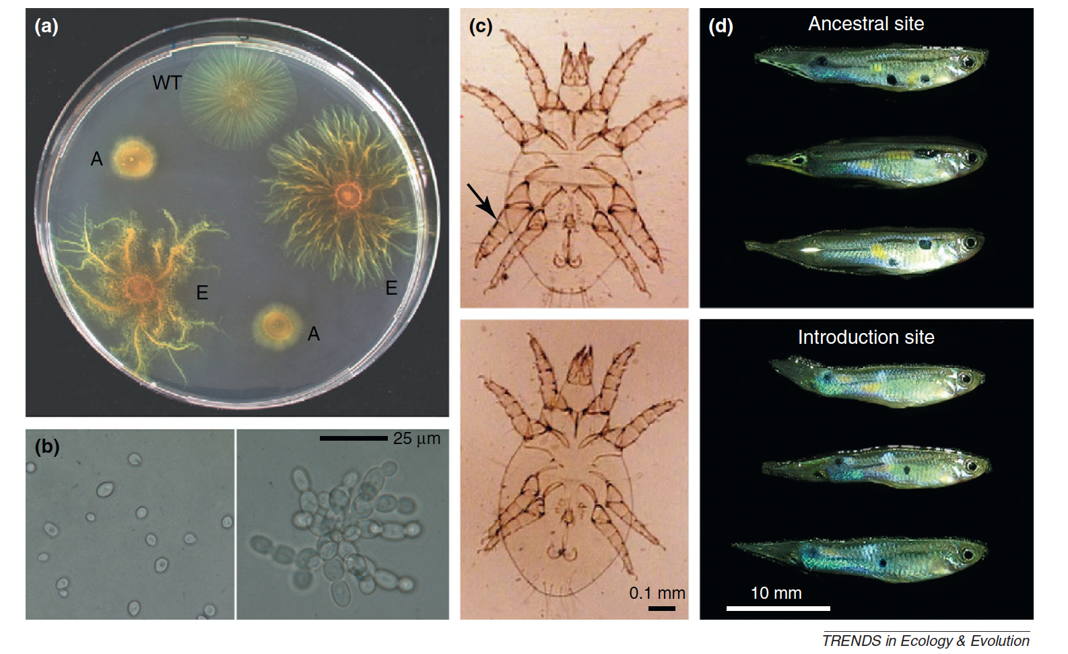
Examples of experimentally evolved phenotypic changes
Evolution of novel swarm morphologies for feeding
Decrease in the frequency of fighter form in a complex environment
“snowflake” yeast evolved under conditions favoring large size
In the absence of predators, guppies evolve brighter coloration (sexual selection)
Kawecki et al., 2012
Notes:
Examples of experimentally evolved phenotypic changes:
Cells of the social bacterium Myxococcus xanthus cooperate to swarm across solid surfaces in search of food and to form multicellular fruiting bodies. Strains initially unable to swarm due to loss of a necessary gene (A) evolved alternative swarming mechanisms, leading to novel swarm morphologies (E) that are markedly different from the ancestral form (WT) [223]. Each swarm contains many millions of cells.
Multicellular ‘snowflake’ yeast (right) experimentally evolved from a single-celled ancestor (left) under conditions favoring large size.
Two male morphs in Rhizoglyphus mites; ‘fighter’ males (top) use their modified third pair of legs (arrow) to kill rival males, but are less mobile than ‘scrambler’ males (bottom). Ten generations of evolution in a complex environment shifted the underlying reaction norm, leading to a substantial decrease in the frequency of the fighter morph [224].
Populations of the guppy (Poecilia reticulata) introduced to sites free of the main predator (bottom) evolved brighter male coloration (here, blue dorsolateral spots and stronger blue-green iridescence on posterior body) compared with their ancestors (top), which evolved with visual predators [201].

Slide 5
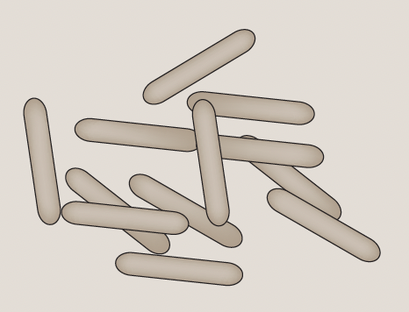
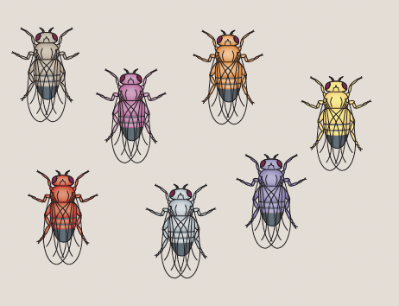
Comparison of study systems for experimental evolution
Microbial isogenic
(e.g. bacteria, yeast)
No sexual recombination
Population size up to 10⁶
No initial genetic variation
No initial genetic variation in fitness
Newly arising mutations are mainly responsible for adaptation
Obligate sexual higher eukaryotes
(e.g. Drosophila)
Obligate sexual recombination
Population size 10²-10³
High initial genetic variation (strains obtained from the wild)
High initial variation in fitness
Standing genetic variation is mainly responsible for adaptation
Long et al., 2015
Notes:
Technological advances have facilitated analysis of the genetic and molecular basis of experimental evolution

Slide 6
Questions that can be addressed with experimental evolution
How do populations adapt to changing environments?
What is the rate of evolution?
What is the phenotypic and genomic architecture of adaptation to changing environments?
Does adaptation occur from new beneficial mutations or standing genetic variation?
Is the genetic architecture of adaptation oligogenic or polygenic?
Is evolution predictable?

Slide 7
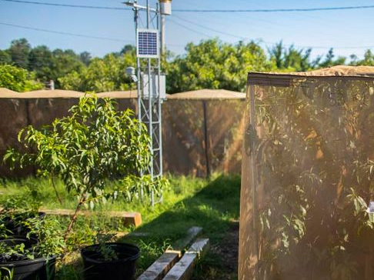


Combine experimental evolution with pooled sequencing in field mesocosms to track adaptive phenotypic and genomic evolution in Drosophila
A unique experimental setup
Fully sequenced inbred Drosophila lines
Large replicate populations
Natural setting
Controlled treatments
No migration
Notes:
Mesocosm Development:
Over the past 10 years, Dmitri Petrov and Paul Schmidt have developed a field mesocosm system.
This setup allows watching seasonal evolution in real time by tracking evolution of phenotypes and genome-wide allele frequencies
Advantages of the Experimental Setup:
Large replicated populations
Natural environmental settings
Controlled treatment conditions
No migration

Slide 8
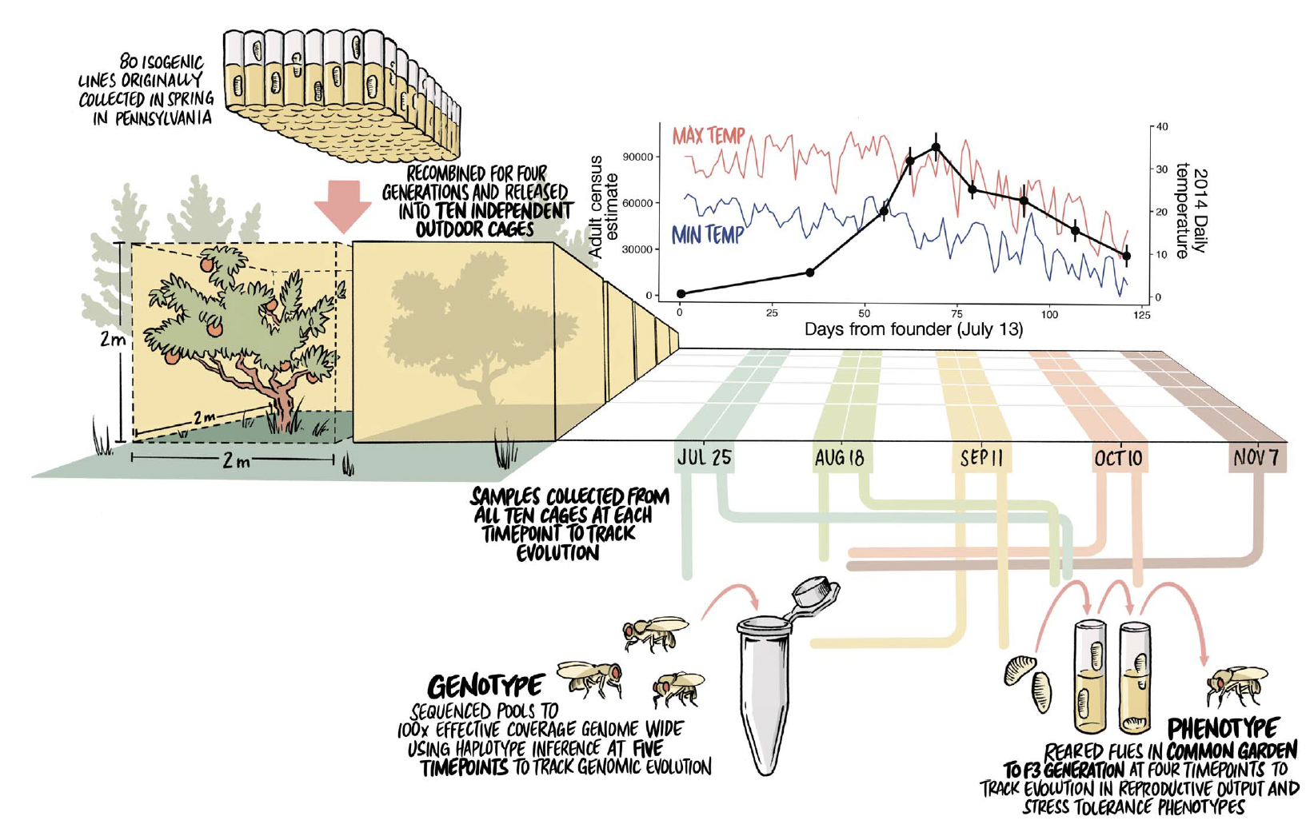
Experimental design to track adaptive phenotypic and genomic evolution to seasonal selection in Drosophila
Rudman, Greenblum et el 2022
Notes:
Experimental Design
Utilize outdoor cages (2m x 2m x 2m) for the experiment
Started with 80 inbred lines collected an orchard in Pennsylvania.
Recombined and expanded these lines to create a diverse outbred population over four generations in the lab.
Founded each of the 10 cages with 500 males and 500 females from the outbred population.
Data Collection:
Monitored daily minimum and maximum temperatures.
Estimated adult population sizes over four months.
Phenotypic Analysis:
Collected eggs from each cage and reared them under common lab conditions for three generations.
Measured fitness-associated phenotypes initially and at four additional time points.
Genomic Analysis:
Sequenced DNA from 100 females per cage to >100× coverage at five different time points.
Analyzed changes in allele frequencies to assess genomic adaptation.

Slide 9
Motivating questions of my research
Why are insecticide-resistant alleles at major effect loci maintained in natural populations?
How does insecticide selection interact with seasonal selection?
Karageorgi et al., unpublished
Notes:
Motivating questions of my research
What keeps insecticide-resistant alleles at major loci in natural populations?
How does insecticide selection interact with seasonal selection?
Method in my research
I used experimental evolution in an orchard to track adaptive changes with and without malathion from Summer to Fall.
Today’s Focus
I'll go through the experimental design and explain some key analyses.
Next Week
I'll provide more details about my research
We'll work together on these analyses.

Slide 10
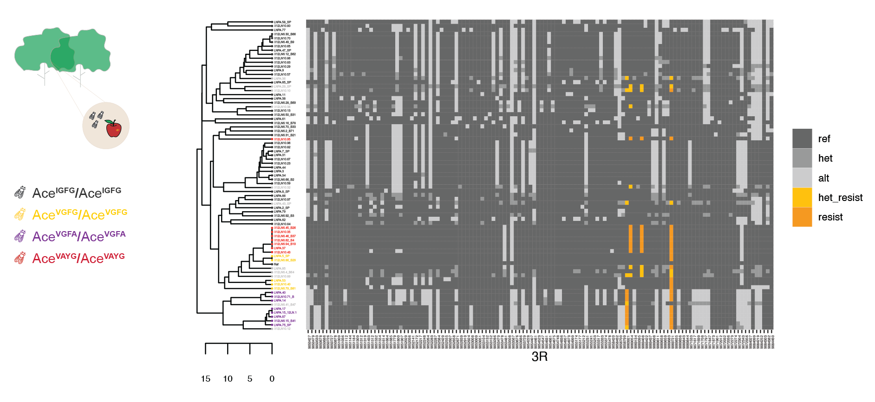
Experimental design to track genomic and phenotypic evolution to temporally fluctuating malathion selection
Panel of 76 inbred lines with standing genetic variation for malathion resistance
Karageorgi et al., unpublished
Notes:
Genetic Variation in Organophosphate Resistance in the inbred lines
The panel of inbred lines were originally collected at an orchard in Pennsylvania
The panel includes fully sequenced inbred lines with standing genetic variation for organophosphate resistance.
Acetylcholinesterase, encoded by the Ace gene, is targeted by organophosphate insecticides.
Four known resistance mutations are known.
Our panel segregates for three resistant Ace alleles (yellow, purple, and orange)

Slide 11
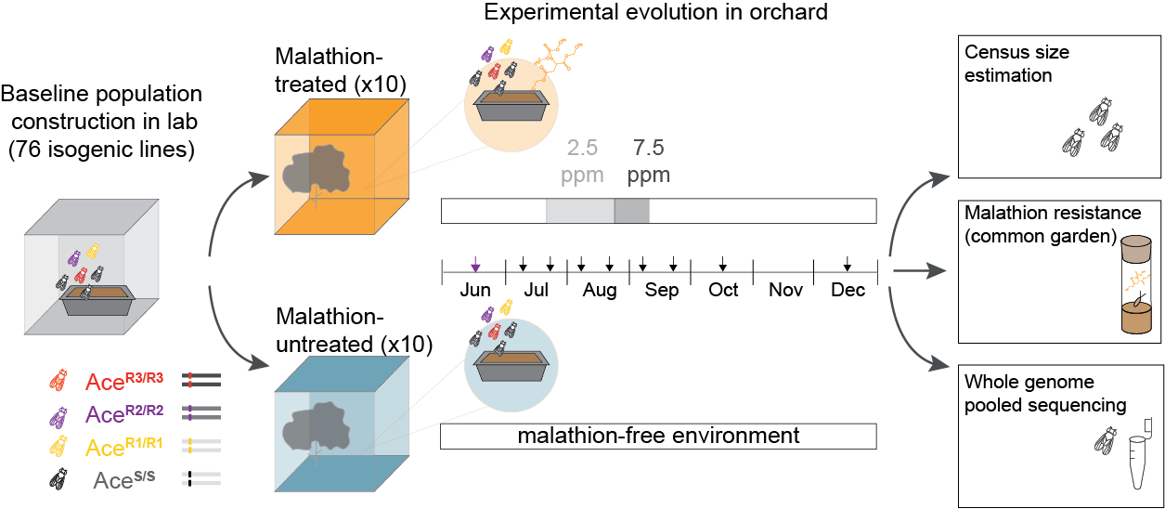
Experimental design to track genomic and phenotypic evolution to temporally fluctuating malathion selection
Karageorgi et al., unpublished
Notes:
Experimental Design and application of malathion
The panel of inbred lines carrying sensitive (AceS) or resistant (AceR1, AceR2, AceR3) Ace alleles were used to construct an outbred baseline population.
The baseline population was used to found each of the 20 mesocosm cages with 500 males and 500 females.
During the establishment phase, no malathion was applied.
During the treatment phase, 10 populations were treated with malathion (2.5ppm malathion light grey, 7.5ppm malathion dark grey).
Throughout the experiment, we performed sampling (eight timepoints, vertical black arrows) every 1- 2 generations.
Data Collection
Estimated adult population sizes over four months.
Phenotypic Analysis
Collected eggs from each cage and reared them under common lab conditions for a generations.
Measured evolution of malathion resistance.
Genomic Analysis
Sequenced DNA from 100 females per cage to >100× coverage at eight time points.
Analyzed changes in allele frequencies to assess genomic adaptation.

Slide 12
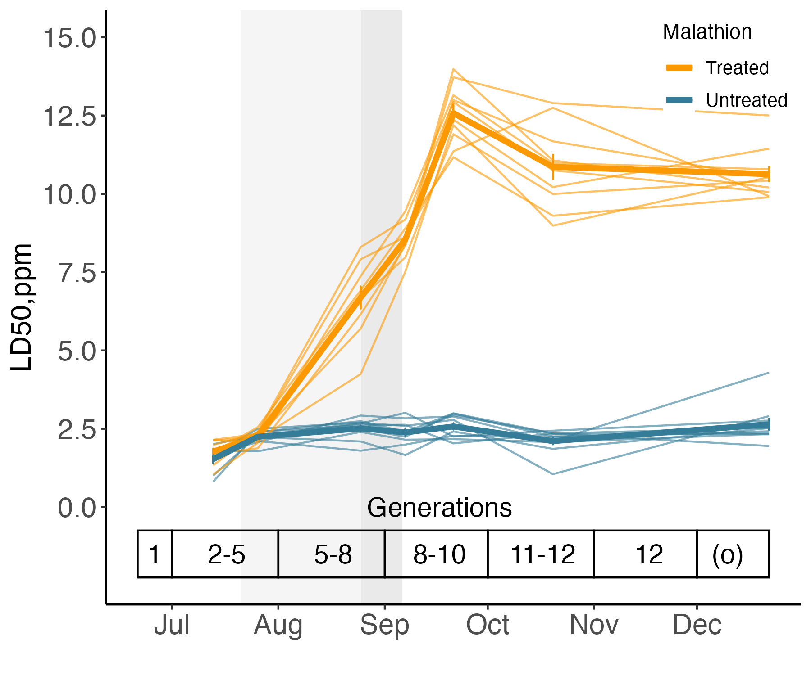
Rapid evolution of resistance to temporally fluctuating malathion selection
Karageorgi et al., unpublished
Notes:
At the phenotypic level, track evolution of resistance
LD50 is a summary measurement of resistance. It is the dose that kills 50% of the population
Light lines and points represent individual malathion-untreated (blue) populations. Dark lines and points represent the mean ± s.e.m. from all ten replicates.
In the absence of selection, resistance was maintained in the untreated populations.
The pulse of malathion led to a rapid increase and subsequent decline of resistance in the malathion-treated populations.
Notice that the cost of resistance is frequency-dependent

Slide 13
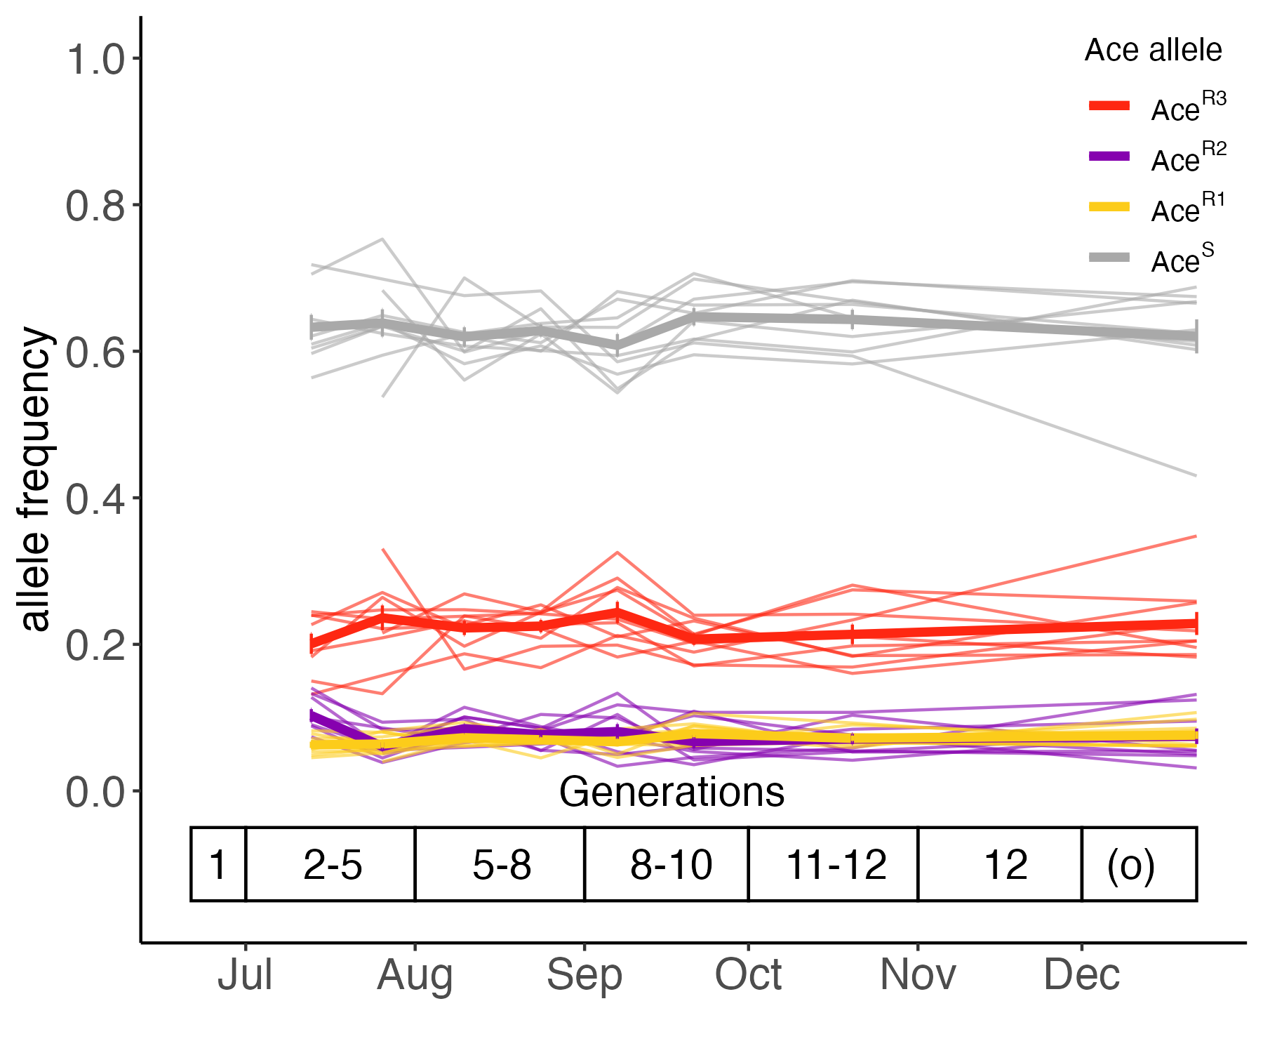
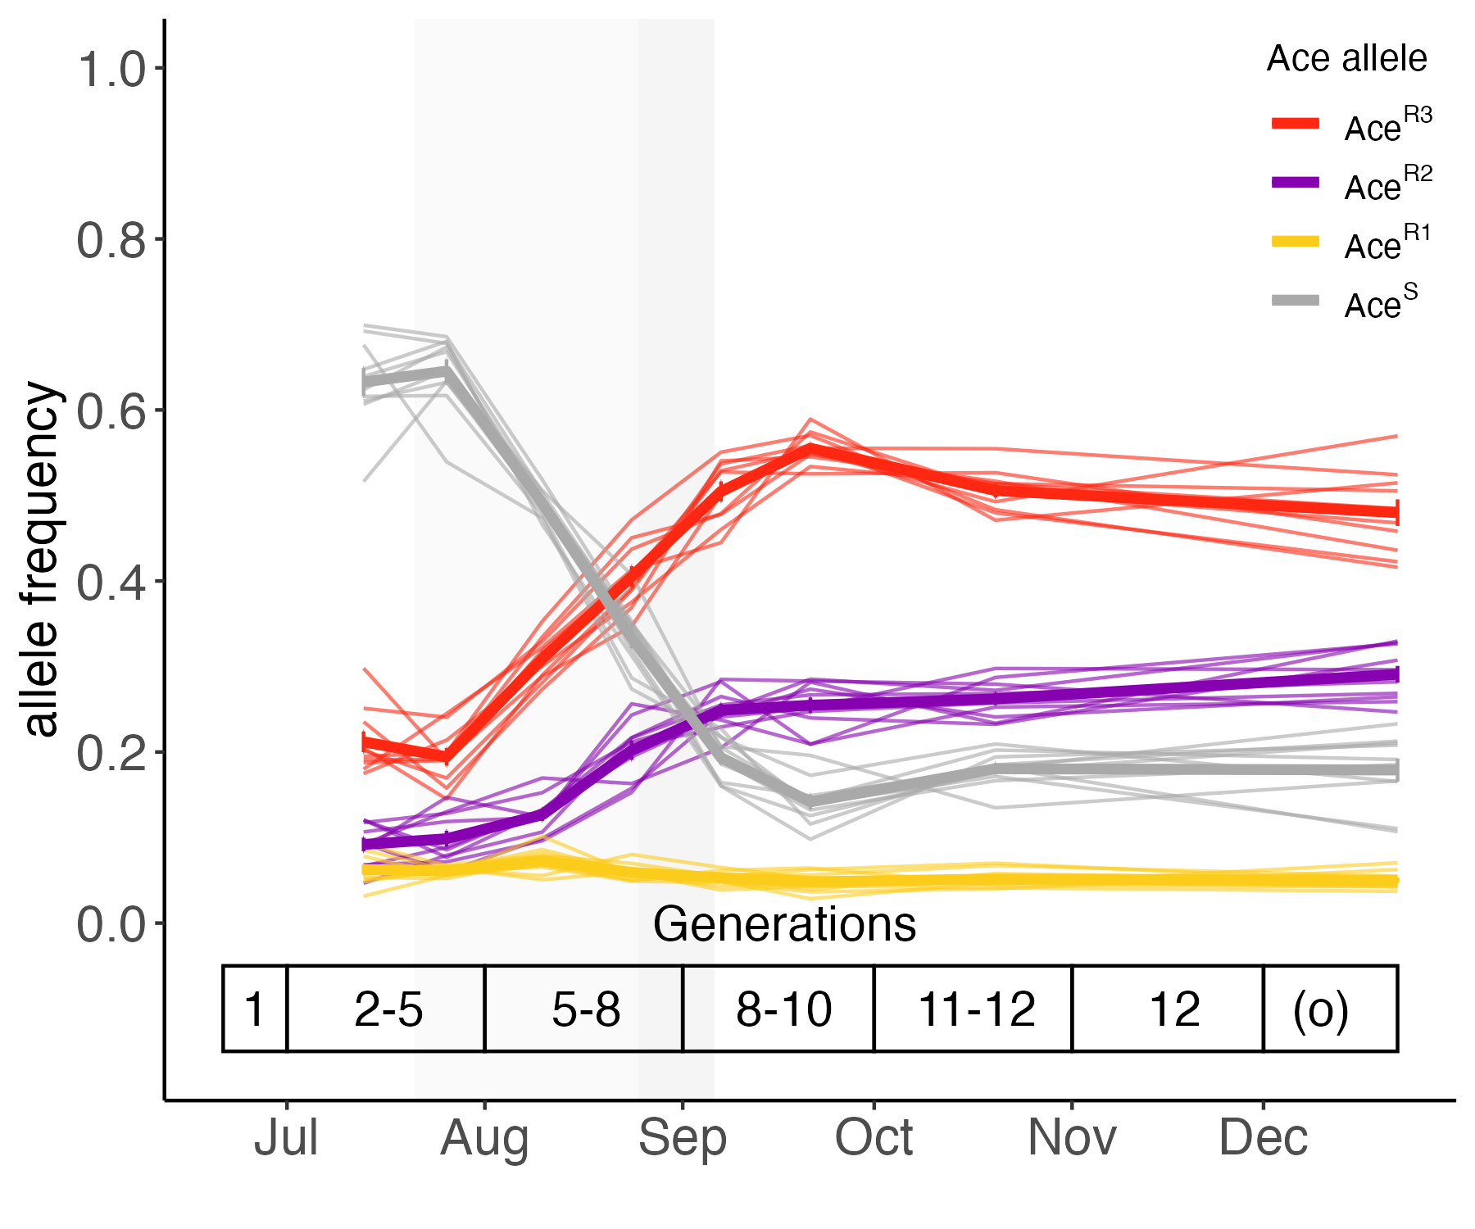
Rapid evolution of resistant Ace alleles to fluctuating malathion selection
Malathion-untreated
Malathion-treated
Teaching module 1:
Track allele frequency trajectories in evolving populations
Karageorgi et al., unpublished
Notes:
How did the frequencies of the resistant Ace alleles change during the experiment?
We tracked the frequency trajectories of the sensitive and resistant Ace alleles in the malathion-untreated and malathion-treated cages
In the absence of selection, the frequency of the resistant Ace alleles did not change over time in the malathion-untreated populations.
On the other hand, the pulse of malathion led to an increase in the frequency of AceR2 and AceR3 and a subsequent decline in the frequency of AceR3 in the malathion-treated populations.
As we observed at the phenotypic level, the cost of resistance is frequency-dependent.
I will provide further explanations next week why the resistant alleles are maintained when present in low frequencies
In the class next week, you will learn how to track allele frequency trajectories

Slide 14
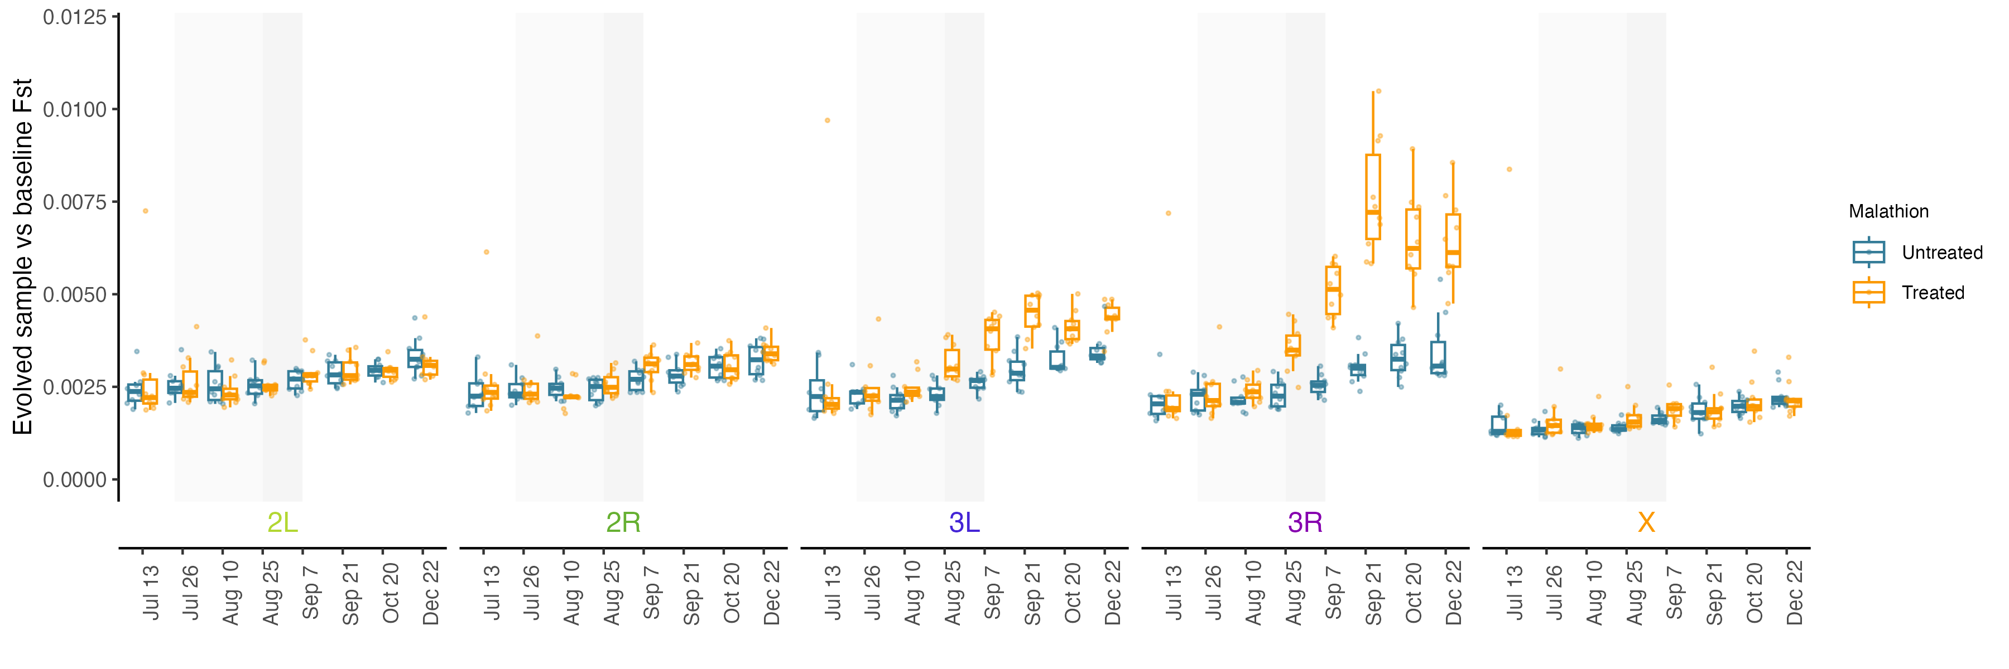
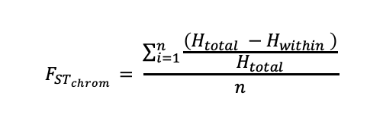
Malathion selection led to an initial increase and subsequent decline of genomic differentiation
$$F_{ST_{chrom }}= \frac{\sum_{i=1}^{n}{\frac{\left(H_{total} −H_{within} \right)}{H_{total}}}}{n}$$
Teaching module 2:
Use Fst to measure genomic differentiation over time in evolving populations
Karageorgi et al., unpublished
Notes:
Did the populations diverge over time during the experiment and what was the effect of malathion?
We used Fst statistic to measure genomic differentiation.
Specifically, we measured pairwise Fst between the evolving populations and the baseline populations.
Here, we plot pairwise Fst between the baseline and evolving populations at each timepoint.
We find that differentiation increases over time in the malathion-untreated populations
The malathion treatment led to an increase and subsequent decrease of genomic differentiation from the baseline population
Notice the increased differentiation on the right arm of the second chromosome and both the left and right arm of the
third chromosome.
Also notice the decline of differentiation after the removal of malathion
The increased differentiation at the third chromosome was expected because Ace -target of malathion – is located on the third chromosome.
In the class next week, you will learn how to calculate Fst between populations

Slide 15
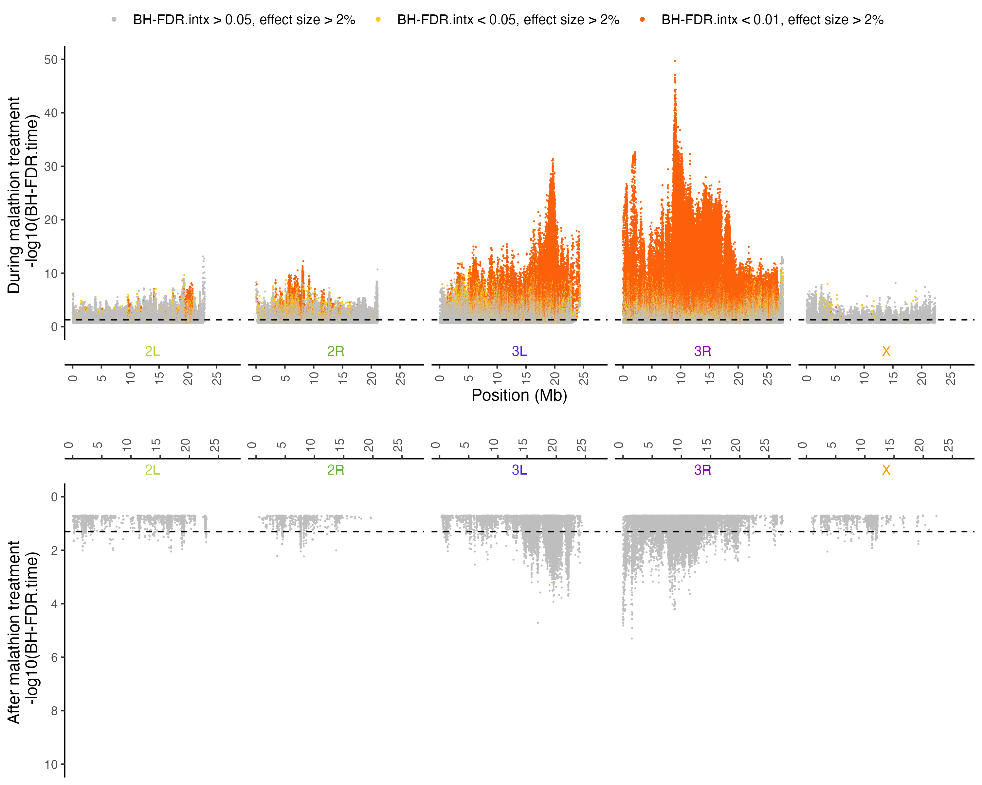
Genomic architecture of adaptation to insecticide selection
$$logit\left(p_{a}\right)=\log\left(\frac{p_{a}}{1− p_{a}}\right)=b_{0}+b_{1} × time+b_{2} × treatment+ b_{3} × time × treatment+e$$
Teaching module 3:
Detect genomic regions under selection
Karageorgi et al., unpublished
Notes:
What is the genomic architecture of adaptation to malathion?
We first fit logistic model to allele counts of each SNP to detect significant allele frequency changes over time and between treatments.
The p value of SNPs are plotted in Manhattan plots.
Here, we see sites that evolved over time (grey) and site that were affected by treatment (orange)
The peak of the chimney corresponds to Ace

Slide 16
Syllabus - Week 2 Outline
Monday (Lecture)
Motivation and details of the experimental evolution study in Drosophila
Install R and necessary packages
Tuesday (Lecture and Hands-on Activity)
Design and genomic data of a study combining experimental evolution with next-generation sequencing
Wednesday (Lecture and Hands-on Activity)
Statistical approaches to measure genetic differences between populations in an experimental evolution study
Thursday & Friday (Lecture and Hands-on Activity)
Statistical approaches to detect genomic regions under selection in an experimental evolution study

